Slide 1
Structured system design
By Monali Gandhi

Slide 2
Structured System Design
3.1 Introduction
Design is a meaningful activity needed to develop a quality product. Design is the only way by which we can accurately translate the customer’s requirements into a finished software product or system. Thus design serves as the basis for all the software engineering steps. In this chapter we will get introduced with the systematic approach to design process. We will discuss architectural design, user interface design and real time software design.

Slide 3
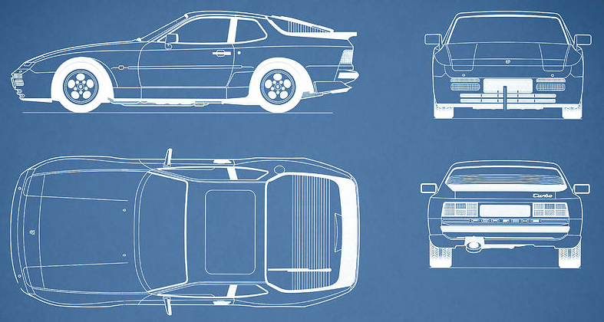
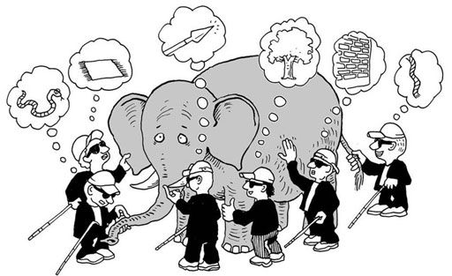
What is Design?
A meaningful representation of something to be built
It's a process by which requirements are translated into blueprint for constructing a software
Blueprint gives us the holistic view (entire view) of a software
SRS
Design
Process
Software
Design
Problem
Domain
Solution
Domain

Slide 4
Conti…
3.1.1 Importance of software Design
Design allows a software engineer to create a model of the system or product that is to be built. This model is useful to access quality improvements. The assessment of quality can be done before code generation. A large number of users can be involved in development process if design model is prepared. In short, design where software quality can be assured.

Slide 5


Software Design Process?
Software design is the most creative part of the development process
Requirement
Engineering
Analysis
Model
Design
Engineering
Design
Model
Process involves
Diversification & Convergence
Blue Print for Constructing Software

Slide 6
Design Models
It is creative activity. It is most critical activity during system development
Analysis Models
Has great impact on testing and maintenance
Scenario-based elements
Use cases - text
Use-case diagrams
Activity diagrams
Swimlane diagrams
Design document forms reference for later phases
Flow-oriented elements
Data flow diagrams
Control-flow diagrams
Processing narratives
Procedural
Design
Procedural description of Software components
Behavioral elements
State diagrams
Sequence diagrams
Interface Design
Human computer interaction
Architectural Design
Relationship among structural elements
Class-based elements
Class diagrams
Analysis packages
CRC models
Collabortion diagrams
Data/Class Design
Data Structure

Slide 7


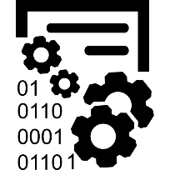

Design Models Cont.
Data Design
Architectural Design
Interface Design
Procedural Design
It transforms structural elements of software into procedural description of software components
It transforms class models into design class realization and prepares data structure (data design) required to implement the software.
It defines the relationship between major structural elements of the software
It defines how software communicates with systems & with humans. An interface implies flow of information & behavior.

Slide 8
Quality attributes of software design
The FURPS quality attributes
F
Functionality
U
Usability
assessed by feature set and capabilities of the program, generality of the functions & security of overall system
assessed by considering human factors, overall aesthetics, consistency & documentations
R
Reliability
P
Performance
assessed by measuring frequency & severity of failures, accuracy of outputs, mean-time-of-failure (MTTF), ability to recover from errors
measured by processing speed, response time, resource consumption, throughput and efficiency
S
Supportability
Ability to extend program, adaptability, serviceability, testability, compatibility

Slide 9
Conti…
3.2 Design Concepts
The software design concept provides a framework for implementing the right software.
Following are certain issues that considered while designing the software
Abstraction
Modularity
Architecture
Refinement
Pattern
Information hiding
Functional independence
Refactoring
Design Issue

Slide 10
Design Concepts
The beginning of wisdom for a software engineer is to recognize the difference between getting program to work and getting it right
Fundamental software design concepts provide the necessary framework
for
“getting it right.”
Each design concept helps to answer the following questions
What criteria can be used to partition software into individual components?
How is function or data structure detail separated from a conceptual representation of the software?
What uniform criteria define the technical quality of a software design?

Slide 11
3.2.1 Abstraction
The abstraction means an ability to cope with the complexity. At each stage of software design process levels of abstractions should be applied to refine the software solution. At the higher level of abstraction, the solution should be stated in broad terms and in the lower level more detailed description of the solution is given.
While moving through different levels of abstraction the procedural abstraction and data abstraction are created.
The procedural abstraction gives the named sequence of instructions in the specific function. That means the functionality of procedure is mentioned by its implementation details are hidden. For example: Search the Record is a procedural abstraction in which implementation details are hidden(i.e. Enter the name, compare each name of the record against the entered one, if a match is found then declare success!! Otherwise declare 'name not found')
In data abstraction the collection of data objects is represented. For example for the procedure search the data abstraction will be Record. The record consists of various attributes such as Record ID, name, address and designation.

Slide 12
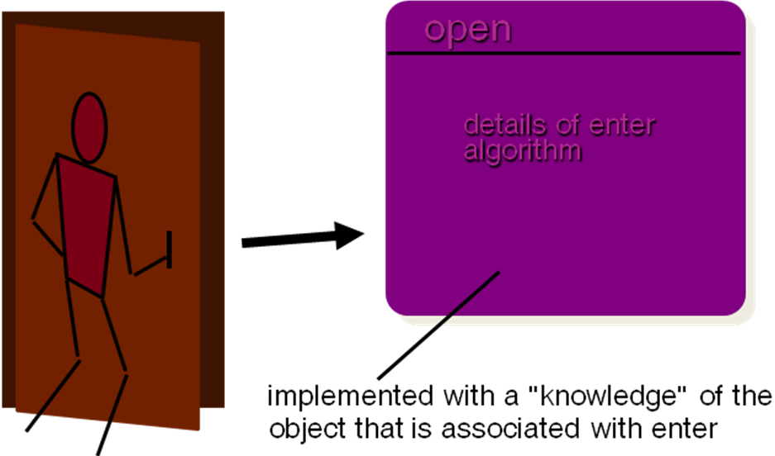
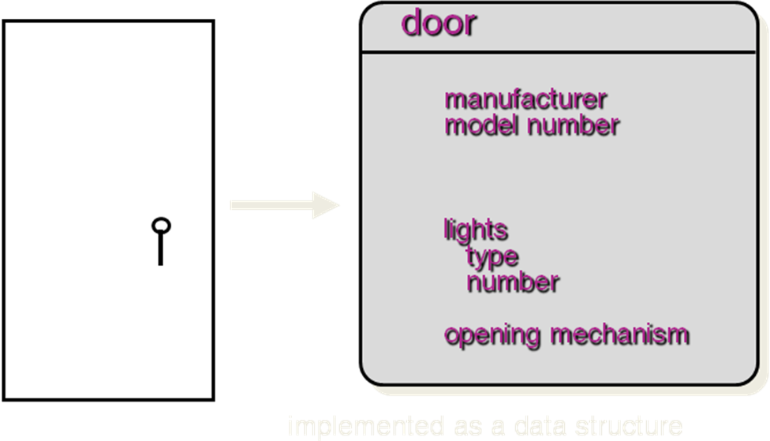
Conti…
Data Abstraction
Procedural Abstraction

Slide 13
3.2.2 Modularity
The software is divided into separately named and addressable components that called as modules
Monolithic software is hard to grasp for the software engineer, hence it has now become a trend to divide the software into number of products. But there is co-relation between the number of modules and overall cost of software products.
Following argument support the idea:
Suppose there are two problems A and B with varying complexity. If the complexity of problem A is greater than complexity of B then efforts required to solve problem A is greater than problem B. That also means, the time required by problem A to get solved is more than that of problem B.

Slide 14
Conti…
The overall complexity of two problems when they are combined is greater than sum of complexity of the problems when considered individually. This leads to divide and conquer strategy.
Thus dividing the software problem into manageable number of pieces leads to concept modularity.
It is possible to conclude that if we subdivide that software indefinitely then effort required to develop each software component will become very small. But this conclusion is invalid because the total number of modules get increased the efforts required for developing each module also get increased. That means cost associated with each effort get increased.

Slide 15
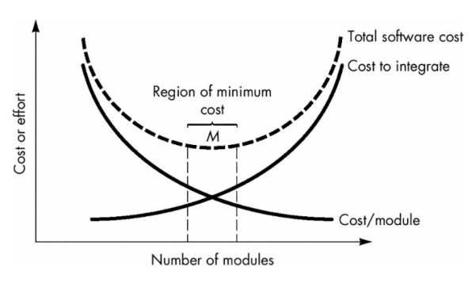
Conti…
The total cost required to develop such software product is shown:

Slide 16
Conti…
Modularization should be such that the development can be planned easily, software increments can be defined and delivered, changes can be more easily accommodated and long term maintenance can be carried out effectively.
Meyer defines five criteria that enable us to evaluate a design method with respect to its ability to define an effective modular system:
Modular decomposability : A design method provides a systematic mechanism for decomposing the problem into sub-problems. This reduces the complexity of the problem and the modularity can be achieved.
Modular composability : A design method enables existing design components to be assembled into a new system.
Modular understandability : A module can be understood as a standalone unit. Then it will be easier to build and easier to change.
Modular continuity : Small changes to the system requirements result in changes to individual modules, rather than system-wide changes.
Modular protection : An aberrant condition occurs within a module and its effects are constrained within the module.

Slide 17
Conti…

Slide 18
3.2.3.Architecture
Architecture means representation of overall structure of an integrated system. In architecture various components interact and the data of the structure is used by various components. These components are called system elements. Architecture provides the basic framework for the software system so that important framework activities can be conducted in systematic manner.
In architectural design various system models can be used and these are
Model | Functioning
Structural model | Overall architecture of the system can be represented using this mode!
Framework model | This model shows the architectural framework and corresponding applicability.
Dynamic model | This model shows the reflection of changes on the system due to external events.
Process model | The sequence of processes and their functioning is represented in this model
Functional model | The functional hierarchy occurring in the system is represented by this model.

Slide 19
Conti…
Structural properties. This aspect of the architectural design representation defines the components of a system (e.g., modules, objects, filters) and the manner in which those components are packaged and interact with one another. For example, objects are packaged to encapsulate both data and the processing that manipulates the data and interact via the invocation of methods
Extra-functional properties. The architectural design description should address how the design architecture achieves requirements for performance, capacity, reliability, security, adaptability, and other system characteristics.
Families of related systems. The architectural design should draw upon repeatable patterns that are commonly encountered in the design of families of similar systems. In essence, the design should have the ability to reuse architectural building blocks.

Slide 20
3.2.4 Refinement
Refinement is actually a process of elaboration.
Stepwise refinement is a top-down design strategy proposed by Nikiaus WIRTH.
The architecture of a program is developed by successively refining levels of procedural detail.
The process of program refinement is analogous to the process of refinement and partitioning that is used during requirements analysis.
Abstraction and refinement are complementary concepts. The major difference is that - in the abstraction low-level details are suppressed. Refinement helps the designer to elaborate low-level details.

Slide 21
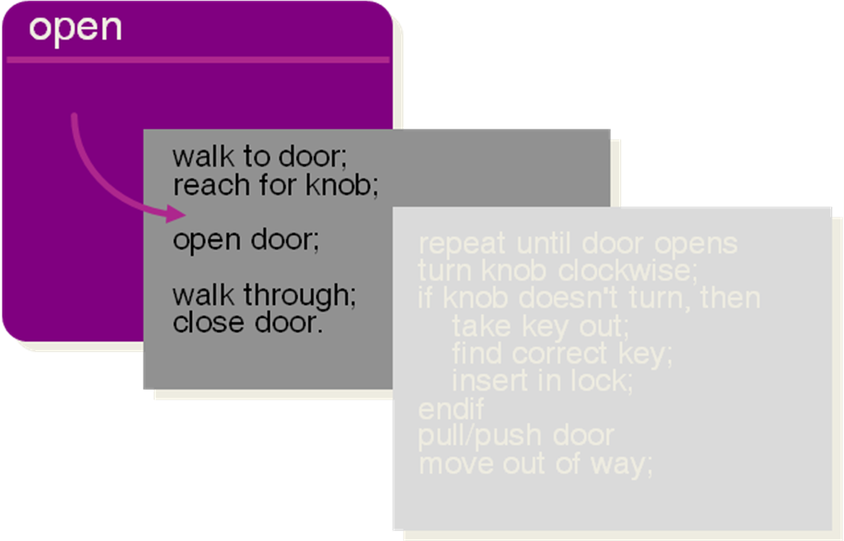
Stepwise Refinement

Slide 22
3.2.5 Pattern
According to Brad Appleton the design pattern can be defined as - It is a named nugget(something valuable) of insight which conveys the essence of proven solution to a recurring problem within a certain context.
In other words, design pattern acts as a design solution for a particular problem occurring in specific domain. Using design pattern designer can determine whether-
Pattern can be reusable
Pattern can be used for current work
Pattern can be used to solve similar kind of problem with different functionality.

Slide 23
Conti…
Pattern name—describes the essence of the pattern in a short but expressive name
Intent—describes the pattern and what it does
Also-known-as—lists any synonyms for the pattern
Motivation—provides an example of the problem
Applicability—notes specific design situations in which the pattern is applicable
Structure—describes the classes that are required to implement the pattern
Participants—describes the responsibilities of the classes that are required to implement the pattern
Collaborations—describes how the participants collaborate to carry out their responsibilities
Consequences—describes the “design forces” that affect the pattern and the potential trade-offs that must be considered when the pattern is implemented
Related patterns—cross-references related design patterns

Slide 24
3.2.6 Information hiding
It is the characteristics of module in which major design decisions can be hidden from all others. Such hiding is necessary because information of one module cannot be accessed by another module. The advantage of information hiding is that modifications during testing and maintenance can be made independently without affecting the functionality of other modules.

Slide 25
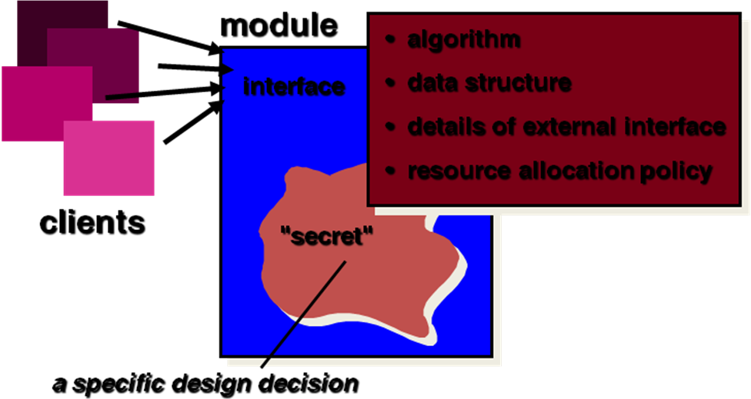
Conti…

Slide 26
Conti…
Why Information Hiding?
Reduces the likelihood of “side effects”
Limits the global impact of local design decisions
Emphasizes communication through controlled interfaces
Discourages the use of global data
Leads to encapsulation—an attribute of high quality design
Results in higher quality software

Slide 27
3.3 Modular design
Modular design reduces complexity and helps in easier implementation. The parallel development of different parts of the system is possible due to modular design.
What is the benefit of modular design?
Changes made during testing and maintenance becomes manageable and they do not affect other modules.
Various quality parameters for effective modular design are
1) Functional independence
2) Cohesion
3) Coupling

Slide 28
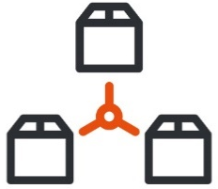



Cohesion & Coupling
A good software design implies clean decomposition of the problem into modules, and the neat arrangement of these modules in a hierarchy.
The primary characteristics of neat module decomposition are high cohesion and low coupling.
A cohesive module performs a single task, requiring little interaction with other components.
A Coupling is an indication of the relative interdependence among modules.

Slide 29
3.3.1 Functional independence
The functional independence can be achieved by developing the functional modules with single-minded approach.
By using functional independence functions may be compartmentalized and interfaces are simplified.
Independent modules are easier to maintain with reduced error propagation.
Functional independence is a key to good design and design is the key to software quality.
The major benefit of functional independence is in achieving effective modularity.

Slide 30
3.3.2 Cohesion
With the help of cohesion the information hiding can be done.
A cohesive module performs only "one task" in software procedure with little interaction with other modules. In other words cohesive module performs only one thing.
Different types of cohesion are :
Coincidentally cohesive - The modules in which the set of tasks are related with each other loosely then such modules are called coincidentally cohesive.
Logically cohesive - A module that performs the tasks that are logically related with each other is called logically cohesive.
Temporal cohesion - The module in which the tasks need to be executed in some specific time span is called temporal cohesive.

Slide 31
Conti…
Procedural cohesion - When processing elements of a module are related with one another and must be executed in some specific order then such module is called procedural cohesive.
Communicational cohesion - When the processing elements of a module share the data then such module is communicational cohesive.
The goal is to achieve high cohesion for modules in the system.

Slide 32
Cohesion
Classification of Cohesion
Cohesion is an indication of the relative functional strength of a module.
A cohesive module performs a single task, requiring little interaction with other components.
Stated simply, a cohesive module should (ideally) do just one thing.
A module having high cohesion and low coupling is said to be functionally independent of other modules.
By the term functional independence, we mean that a cohesive module performs a single task or function.
Classification of Cohesion
Coincidental
Low
Logical
Temporal
Procedural
Communicational
Sequential
Functional
High

Slide 33
Classification of Cohesion cont.
Coincidental cohesion
Logical cohesion
A module is said to have coincidental cohesion, if it performs a set of tasks that relate to each other very loosely.
In this case, the module contains a random collection of functions.
It is likely that the functions have been put in the module out of pure coincidence without any thought or design.
For Ex., in a transaction processing system (TPS), the get-input, print-error, and summarize-members functions are grouped into one module
At the outer layer, components service user interface operations.
A module is said to be logically cohesive, if all elements of the module perform similar operations.
For Ex., error handling, data input, data output, etc.
An example of logical cohesion is the case where a set of print functions generating different output reports are arranged into a single module In this case, the module contains a random collection of functions.

Slide 34
Classification of Cohesion cont.
Temporal cohesion
Procedural cohesion
When a module contains functions that are related by the fact that all the functions must be executed in the same time span.
For Ex., the set of functions responsible for initialization, start-up, shutdown of some process, etc.
If the set of functions of the module are all part of a procedure (algorithm) in which certain sequence of steps have to be carried out for achieving an objective
For Ex., the algorithm for decoding a message.
Communicational cohesion
If all functions of the module refer to the same data structure
For Ex., the set of functions defined on an array or a stack.

Slide 35
Classification of Cohesion cont.
Sequential cohesion
If the elements of a module form the parts of sequence, where the output from one element of the sequence is input to the next.
For Ex., In a Transaction Processing System, the get-input, validate-input, sort-input functions are grouped into one module.
Functional cohesion
If different elements of a module cooperate to achieve a single function.
For Ex., A module containing all the functions required to manage employees’ pay-roll exhibits functional cohesion.

Slide 36
3.3.3 Coupling
Coupling effectively represents how the modules can be "connected" with other module or with the outside world.
Coupling is a measure of interconnection among modules in a program structure.
Coupling depends on the interface complexity between modules.
The goal is to strive for lowest possible coupling among modules in software design.
The property of good coupling is that it should reduce or avoid change impact and ripple effects. It should also reduce the cost in program changes, testing, and maintenance.

Slide 37
Conti…
Data coupling - The data coupling is possible by parameter passing or data interaction.
Control coupling - The modules share related control data in control
coupling.
Common coupling - In common coupling common data or a global data is shared among the modules.
Content coupling - Content coupling occurs when one module makes use of data or control information maintained in another module.

Slide 38
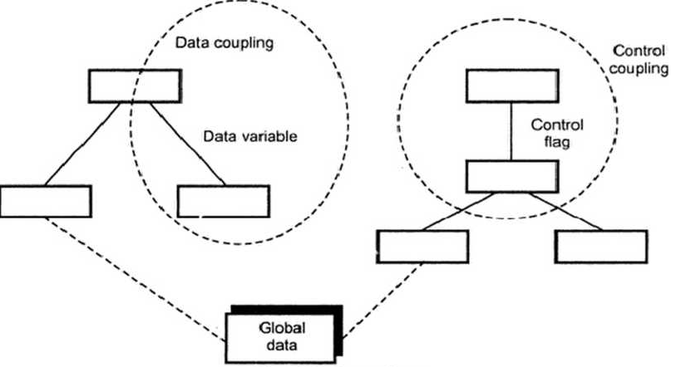

Slide 39
Coupling
Classification of Coupling
Coupling between two modules is a measure of the degree of interdependence or interaction between the two modules.
A module having high cohesion and low coupling is said to be functionally independent of other modules.
If two modules interchange large amounts of data, then they are highly interdependent.
The degree of coupling between two modules depends on their interface complexity.
The interface complexity is basically determined by the number of types of parameters that are interchanged while invoking the functions of the module.
Classification of Coupling
Data
Low
Stamp
Control
Common
Content
High

Slide 40
Classification of Coupling Cont.
Data coupling
Stamp coupling
Two modules are data coupled, if they communicate through a parameter.
An example is an elementary (primal) data item passed as a parameter between two modules, e.g. an integer, a float, a character, etc.
This is a special case (or extension) of data coupling
Two modules (``A'' and ``B'') exhibit stamp coupling if one passes directly to the other a composite data item - such as a record (or structure), array, or (pointer to) a list or tree.
This occurs when ClassB is declared as a type for an argument of an operation of ClassA
Control coupling
If data from one module is used to direct the order of instructions execution in another.
An example of control coupling is a flag set in one module and tested in another module

Slide 41
Classification of Coupling Cont.
Common coupling
If data from one module is used to direct the order of instructions execution in another.
An example of control coupling is a flag set in one module and tested in another module.
Content coupling
Content coupling occurs when one component secretly modifies data that is internal to another component.
This violets information hiding – a basic design concept
Content coupling exists between two modules, if they share code.

Slide 42
3.3.4 Fan-out
Fan-out is measure of the number of immediate subordinates to a module. The fan-out should be within some limit in design. If fan-out is very high then it indicates that a single module is controlling many other modules. Preferably limit fan-out to no more than seven.

Slide 43
3.3.5 Fan-IN
Fan-in indicates how many modules directly control a given module. Modules with fan-in must have good cohesion. Each interface to module must have same number and types of parameters.

Slide 44
Conti…

Slide 45
3.3.6 Refactoring
Refactoring is necessary for simplifying the design without changing the function or behaviour. Fowler has defined refactoring as the process of changing a software system in such a way that the external behavior of the design do not get changed, however the internal structure gets improved.
Benefits of refactoring are -
The redundancy can be achieved.
Inefficient algorithms can be eliminated or can be replaced by efficient one.
Poorly constructed or inaccurate data structures can be removed or replaced.
Other design failures can be rectified.
The decision of refactoring particular component is taken by the designer of the software system.

Slide 46
Conti…
Fowler [FOW99] defines refactoring in the following manner:
"Refactoring is the process of changing a software system in such a way that it does not alter the external behavior of the code [design] yet improves its internal structure.”
When software is re-factored, the existing design is examined for
redundancy
unused design elements
inefficient or unnecessary algorithms
poorly constructed or inappropriate data structures,
or any other design failure that can be corrected to yield a better design.

Slide 47
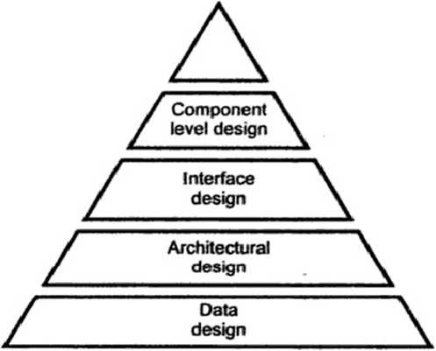
3.4 Design Models

Slide 48
Conti…
The design model is represented as pyramid. The pyramid is a stable object Representing design model in this way means that the software design should be stable.
The design model has broad foundation of data design, stable mid-region with architectural and interface design and the sharp point to for component level design.
The design model represents that the software which we create should be stable such that any changes should not make it collapsed. And from such a stable design a high quality software should be generated.

Slide 49
Conti…

Slide 50
Conti…
Data elements
Data model --> data structures
Data model --> database architecture
Architectural elements “similar to the floor plan of a house”
“You can use an eraser on the drafting table or a sledge hammer on the construction site.”
Application domain
Analysis classes, their relationships, collaborations and behaviors are transformed into design realizations
Patterns and “styles”

Slide 51
Conti…
Interface elements “The way in which utilities connections come into the house and are distributed among the rooms”
the user interface (UI)
external interfaces to other systems, devices, networks or other producers or consumers of information
internal interfaces between various design components

Slide 52
Conti…
Component elements
It is equivalent to a set of detailed drawings and specs for each room in a house.
The component-level design for software fully describes the internal detail of each software component.
Deployment elements
Indicates how software functionally and subsystem terms will be allocated within the physical computing environment that will support the software.

Slide 53
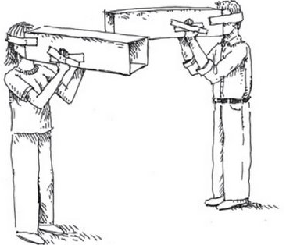
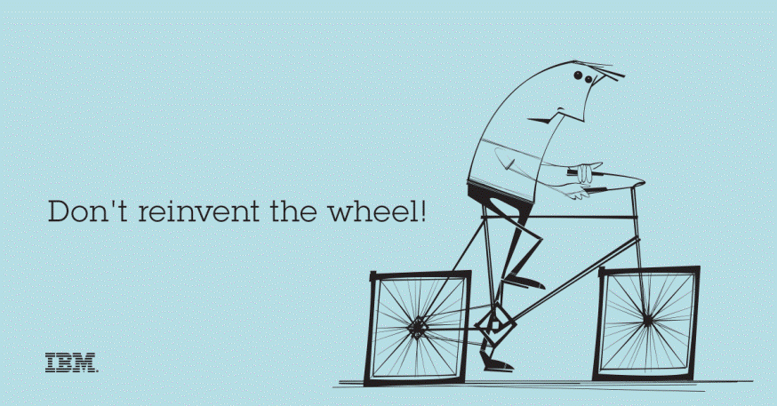

3.4.1 Design Principles
Design process should not suffer from “tunnel vision”
Design should be structured to degrade gently, even when abnormal data, events, or operating conditions are encountered
Design should be traceable to the analysis model
Design should not reinvent the wheel
Design is not coding, coding is not design
Design should “minimize the intellectual distance” between the software and the real world problem
Design should be assessed for quality as it is being created, not after the fact
Design should exhibit (present) uniformity and integration
Design should be reviewed to minimize conceptual (semantic) errors
Design should be structured to accommodate change
Tunnel Vision
Reinvent the Wheel
Coding
Design

Slide 54
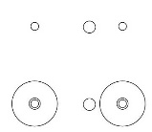
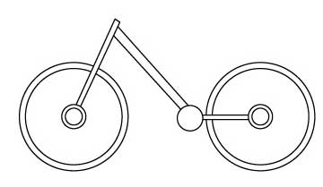
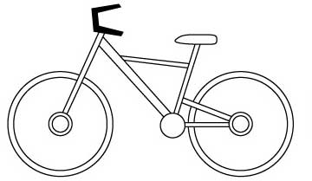
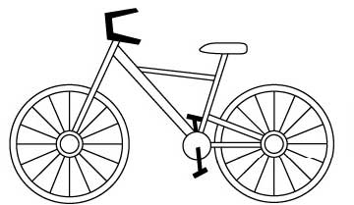
Design Process Rough View
Informal Design Outline
Informal Design
More formal Design
Finished Design
Design Process
Requirements Specification
Design Activities
Architectural
Design
Abstract
Specification
Interface
Design
Component
Design
Data Structure
Design
Algorithm
Design
System
Architecture
Software
Specification
Interface
Specification
Component
Specification
Data Structure
Specification
Algorithm
Specification
Design Product

Slide 55
3.4.2 characteristics of good design
The good design should implement all the requirements that are explicitly mentioned in analysis model. It should accommodate all implicit requirements demanded by customer.
The design should be simple enough so that the code developer, code tester as well as those who are supporting the software will find it readable and understandable.
The design should be comprehensive. That means it should provide a complete picture of software, addressing the data, functional and behavioural domains from an implementation perspective.

Slide 56
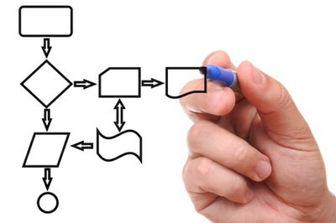
Software design work products
Characteristics of good Design
For a design to be easily implemented in a conventional programming language, the following items must be designed during the design phase.
The design must implement all explicit requirements available in requirement model
The design must accommodate all implicit requirements given by stakeholders
The design must be readable & understandable
The good design should provide complete picture of the software, addressing the data, functional and behavioral domains.
Different modules required to implement the design solution.
Control relationship among the identified modules. The relationship is also known as the call relationship or invocation relationship among modules.
Interface among different modules. The interface among different modules identifies the exact data items exchanged among the modules.
Algorithms required to implement each individual module.
Data structures of the individual modules.

Slide 57
3.5 Software Architecture
This section defines the term “software architecture” as a framework made up of the system structures that comprise the software components, their properties, and the relationships among these components. The goal of the architectural model is to allow the software engineer to view and evaluate the system as a whole before moving to component design.
What is Architecture?
The architecture is not the operational software. Rather, it is a representation that enables a software engineer to:
(1) Analyze the effectiveness of the design in meeting its stated requirements,
(2) Consider architectural alternatives at a stage when making design changes is still relatively easy, and
(3) Reduce the risks associated with the construction of the software.

Slide 58
Conti…
Why is Architecture Important?
Representations of software architecture are an enabler for communication between all parties (stakeholders) interested in the development of a computer-based system.
The architecture highlights early design decisions that will have a profound impact on all software engineering work that follows and, as important, on the ultimate success of the system as an operational entity.
Architecture “constitutes a relatively small, intellectually graspable model of how the system is structured and how its components work together”

Slide 59
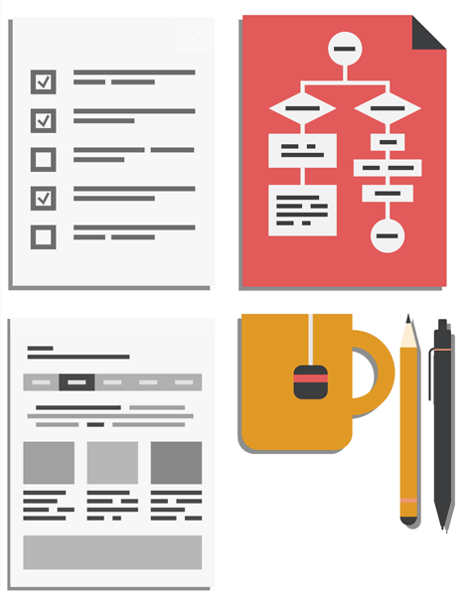

Architectural Design
Software Architecture & Design
Large systems are decomposed into subsystems
Sub-systems provide related services
Initial design process includes
Identifying sub-systems
Establishing a framework for sub-system control and communication
Why to document the Architecture?
Stakeholder Communication: High-level presentation of system
System Analysis: Big effect on performance, reliability, maintainability and other –ilities (Usability, Maintainability, Scalability, Reliability, Extensibility, Security, Portability)
Large-scale Reuse: Similar requirements similar architecture

Slide 60

Software Architecture & Design
Architectural design represents the structure of data and program components
It considers
Architectural style that the system will take
Structure and properties of the components that constitute the system
Marry in haste
repent at leisure
Interrelationships that occur among all architectural components of a system
Representations of software architecture are an enabler for communication between all parties (stakeholders).
Architecture “constitutes a relatively small, intellectually graspable model of how the system is structured and how its components work together”
True for Software Architecture Design

Slide 61
3.6 Data Design
Data design is basically the model of data that is represented at the high level of abstraction.
The data design is then progressively refined to create implementation specific representations.
Various elements of data design are
o Data object - The data objects are identified and relationship among various data objects can be represented using entity relationship diagrams or data dictionaries.
o Databases - Using software design model, the data models are translated into data structures and databases at the application level.
o Data warehouses - At the business level useful information is identified from various databases and the data warehouses are created. For extracting or navigating the useful business information stored in the huge data warehouse then data mining techniques are applied.

Slide 62
3.6.1 Data Design at the Architectural Level
The challenge is extract useful information from the data environment, particularly when the information desired is cross-functional.
To solve this challenge, the business IT community has developed data mining techniques, also called knowledge discovery in databases (KDD), that navigate through existing databases in an attempt to extract appropriate business-level information.
However, the existence of multiple databases, their different structures, the degree of detail contained with the databases, and many other factors make data mining difficult within an existing database environment.
An alternative solution, called a data warehouse, adds on additional layer to the data architecture.
A data warehouse is a separate data environment that is not directly integrated with day-to-day applications that encompasses all data used by a business.
In a sense, a data warehouse is a large, independent database that has access to the data that are stored in databases that serve as the set of applications required by a business.

Slide 63
3.6.2 Data Design at the Component Level
At the component level, data design focuses on specific data structures required to realize the data objects to be manipulated by a component.
refine data objects and develop a set of data abstractions
implement data object attributes as one or more data structures
review data structures to ensure that appropriate relationships have been established
simplify data structures as required

Slide 64
Set of principles for data specification:
1. Apply systematic analysis on data
Represent data objects, relationships among them and data flow along with the contents.
2. Identify data structures and related operations
For the design of efficient data structures all the operations that will be performed on it should be considered.
3. Establish data dictionary
The data dictionary explicitly represents various data objects, relationships among them and the constraints on the elements of data structures.
4. Defer the low-level design decisions until late in the design process
Major structural attributes are designed first to establish an architecture of data. And then low-level design attributes are established.

Slide 65
Conti…
5. Use information hiding in the design of data structures
The use of information hiding helps in improving quality of software design. It also helps in separating the logical and physical views.
6. Apply a library of useful data structures and operations
The data structures can be designed for reusability. A use of library of data structure templates (called as abstract data types) reduces the specification and design efforts for data.
7. Use a software design and programming language to support data specification and abstraction
The implementation of data structures can be done by effective software design
and by choosing suitable programming language.

Slide 66
3.7 Architectural Styles and patterns
The architectural model or style is a pattern for creating the system architecture for given problem. However, most of the large systems are heterogeneous and do not follow single architectural style.
System categories define the architectural style.
1. Components : They perform a function.
For example: Database, simple computational modules, clients, servers and filters.
2. Connectors : Enable communications. They define how the components communicate, co-ordinate and co-operate.
For example, Call, event broadcasting, pipes.
3. Constraints : Define how the system can be integrated.
4. Semantic models : Specify how to determine a system's overall properties from the properties of its parts.

Slide 67
Conti…
The commonly used architectural styles are
Data centered architectures
Data flow architectures
Call and return architectures
Object oriented architectures
Layered architectures.

Slide 68
3.7.1.1 Data Centered Architectures
In this architecture the data store lies at the center of the architecture and other components frequently access it by performing add, delete, and modify operations. The client software requests for the data to central repository. Sometime the client software accesses the data from the central repository without any change in data or without any change in actions of software actions.
Data centered architecture posses the property of interchangeability. Interchangeability means any component from the architecture can be replaced by a new component without affecting the working of other components.
In data centered architecture the data can be passed among the components.

Slide 69
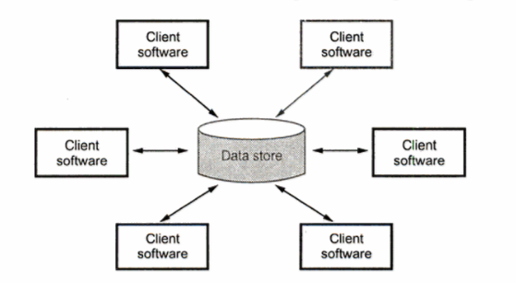
In data centered architecture
Components are: Database elements such as tables, queries.
Communication are: By relationships.
Constraints are: Client software has to request central data store for information.

Slide 70
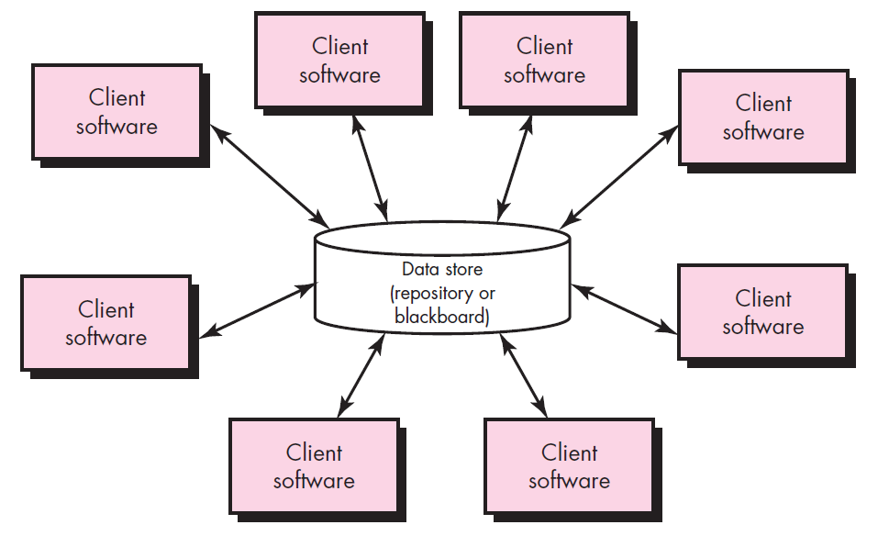
Data-centered architecture style
A data store (Ex., a file or database) resides at the center of this architecture and is accessed frequently by other components.
Client software accesses a central repository.
In some cases the data repository is passive
That is, client software accesses the data independent of any changes to the data or the actions of other client software.

Slide 71
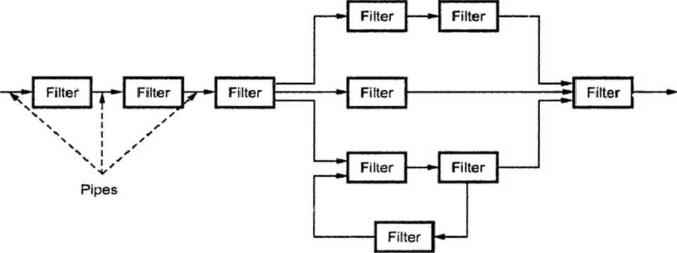
3.7.1.2 Data Flow Architectures
In this architecture series of transformations are applied to produce the output data. The set of components called filters are connected by pipes to transform the data from one component to another. These filters work independently without a bothering about the working of neighboring filter.

Slide 72

Conti…
If the data flow degenerates into a single line of transforms, it is termed as batch sequential.
In this pattern the transformation is applied on the batch of data.

Slide 73
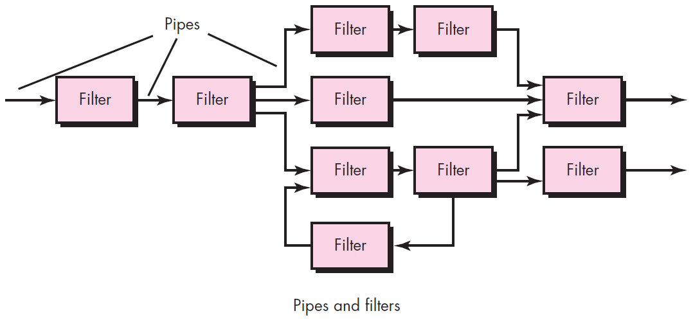
Data-flow architectures
This architecture is applied when input data are to be transformed.
A set of components (called filters) connected by pipes that transmit data from one component to the next.
Each filter works independently of those components upstream and downstream, is designed to
expect data input of a certain form, and
produces data output (to the next filter) of a specified form.

Slide 74
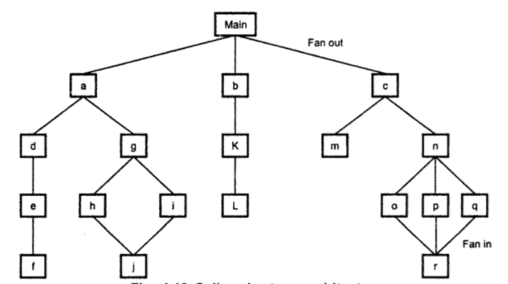
3.7.1.3 Call and Return Architecture
The program structure can be easily modified or scaled. The program structure is organized into modules within the program. In this architecture how modules call each other. The program structure decomposes the function into control hierarchy where a main program invokes number of program components.
In this architecture the hierarchical control for call and return is represented.

Slide 75
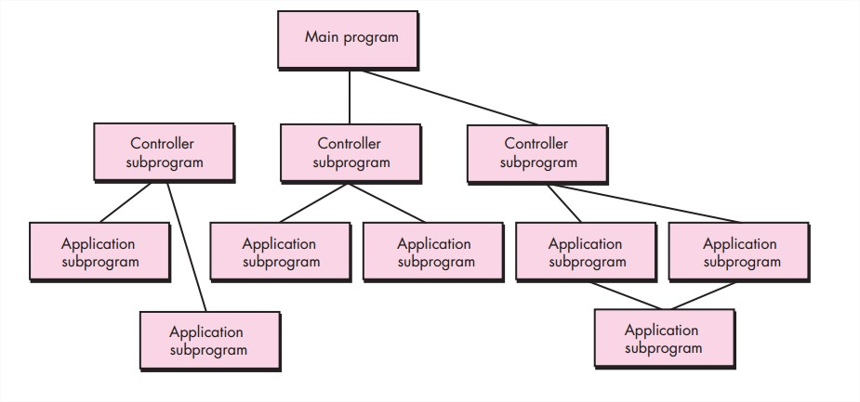
Call and return architecture
This architectural style enables a software designer (system architect) to achieve a program structure that is relatively easy to modify and scale.
A number of sub styles exist within this category as below.
Main program/subprogram architectures
This classic program structure decomposes function into a control hierarchy where a “main” program invokes a number of program components, which in turn may invoke still other components.
Remote procedure call architectures
The components of a main program/subprogram architecture are distributed across multiple computers on a network.

Slide 76
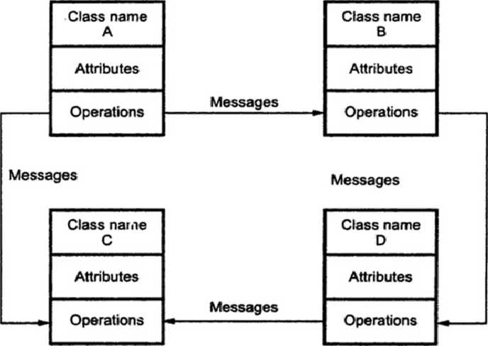
3.7.1.4 Object Oriented Architecture
In this architecture the system is decomposed into number of interacting objects.
These objects encapsulate data and the corresponding operations that must be applied to manipulate the data.
The object oriented decomposition is concerned with identifying objects classes, their attributes and the corresponding operations. There is some control models used to co-ordinate the object operations.

Slide 77
3.7.1.5 Layered Architecture
The layered architecture is composed of different layers. Each layer is intended to perform specific operations so machine instruction set can be generated. Various components in each layer perform specific operations.
The outer layer is responsible for performing the user interface operations while the components in the inner layer perform operating system interfaces.
The components in intermediate layer perform utility services and application software functions.

Slide 78
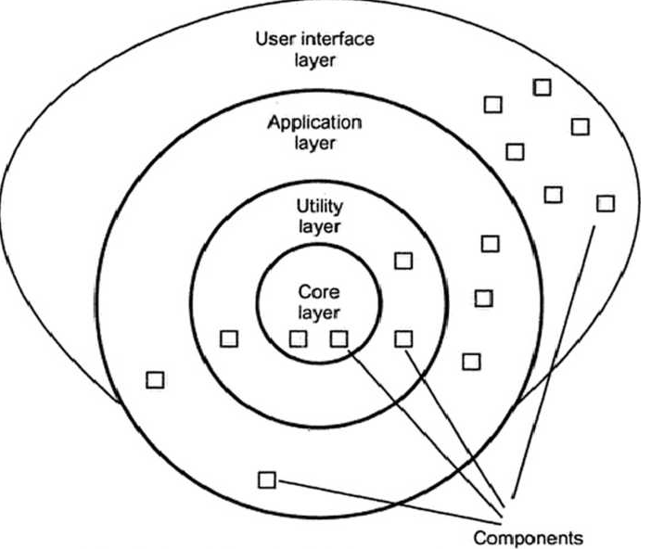

Slide 79
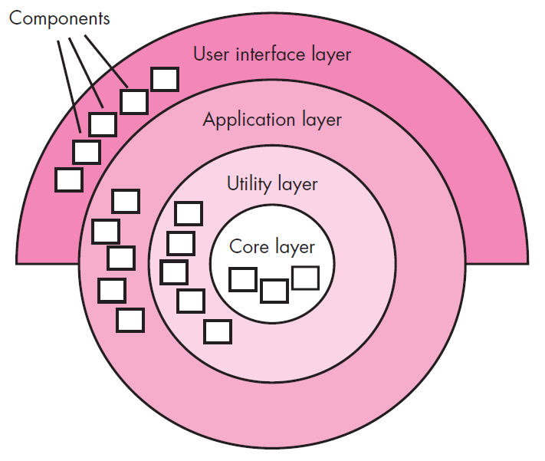
Layered architecture
A number of different layers are defined, each accomplishing operations that progressively become closer to the machine instruction set.
At the outer layer, components service user interface operations.
At the inner layer, components perform operating system interfacing.
Intermediate layers provide utility services and application software functions.

Slide 80
3.7.2 Architectural Patterns
A S/W architecture may have a number of architectural patterns that address issues such as concurrency, persistence, and distribution.
Concurrency—applications must handle multiple tasks in a manner that simulates parallelism
operating system process management pattern
task scheduler pattern
Persistence—Data persists if it survives past the execution of the process that created it. Persistent data are stored in a database or file and may be read and modified by other processes at a later time.
Two patterns are common:
a database management system pattern that applies the storage and retrieval capability of a DBMS to the application architecture
an application level persistence pattern that builds persistence features into the application architecture

Slide 81
Conti…
Distribution— the manner in which systems or components within systems communicates with one another in a distributed environment, and the nature of the communication that occurs.
A broker acts as a ‘middle-man’ between the client component and a server component.

Slide 82
3.8 alternative architectural designs
There are one alternative approaches used for architectural design –
1. To apply iterative method to access design trade-offs

Slide 83
3.8.1 Architecture trade-off analysis method
Various design analysis activities:
1. Collect Scenarios –
Use cases are developed for representing system for user’s point of view. Hence a set of use cases help in collecting scenarios.
2. Elicit requirements, constraints, and environment description –
This information is obtained during requirement analysis. Customer, user and stake-holders must specify the requirement correctly.

Slide 84
3. Describe architectural style chosen for representing scenarios and requirements
The architecture style should describe various views about system. Those views are -
i) Model View – working of components and information hiding can be described
ii) Process View – helps to analyse the system performance
Iii) Data flow view – functional requirement analysis can be made using this analysis
4. Evaluate quality attributes individually –
Various quality attributes that can be evaluated are
Reliability, performance, security, flexibility, maintainability, testability, portability, inter-operatability, reusability

Slide 85
5. Identify sensitivity of quality attribute –
For checking sensitivity of these attribute, small changes are made in architecture and observe the effect of these changes on quality attributes. If any attribute got affected by these changes then that attribute is considered as sensitive point.
6. Criticize quality attribute –
By making small changes in architecture, sensitive points are obtained. Now, architecture trade-off points can be obtained by criticizing these quality factors.
The above 6 iteration represent one complete iteration. Based on result of 5 and 6, some architecture alternatives are eliminated and some modifications are made in architecture. Then these steps are again reapplied.

Slide 86
3.9 What is a Component?
This section defines the term component and discusses the differences between object-oriented, traditional, and process related views of component-level design.
Object Management Group OMG UML defines a component as “… a modular, deployable, and replaceable part of a system that encapsulates implementation and exposes a set of interfaces.”

Slide 87
3.9.1 An Object Oriented View
OO view: a component contains a set of collaborating classes.
Each class within a component has been fully elaborated to include all attributes and operations that are relevant to its implementation. As part of the design elaboration, all interfaces (messages) that enable the classes to communicate and collaborate with other design classes must also be defined. To accomplish this, the designer begins with the analysis model and elaborates analysis classes (for components that relate to the problem domain) and infrastructure classes (or components that provide support services for the problem domain).

Slide 88
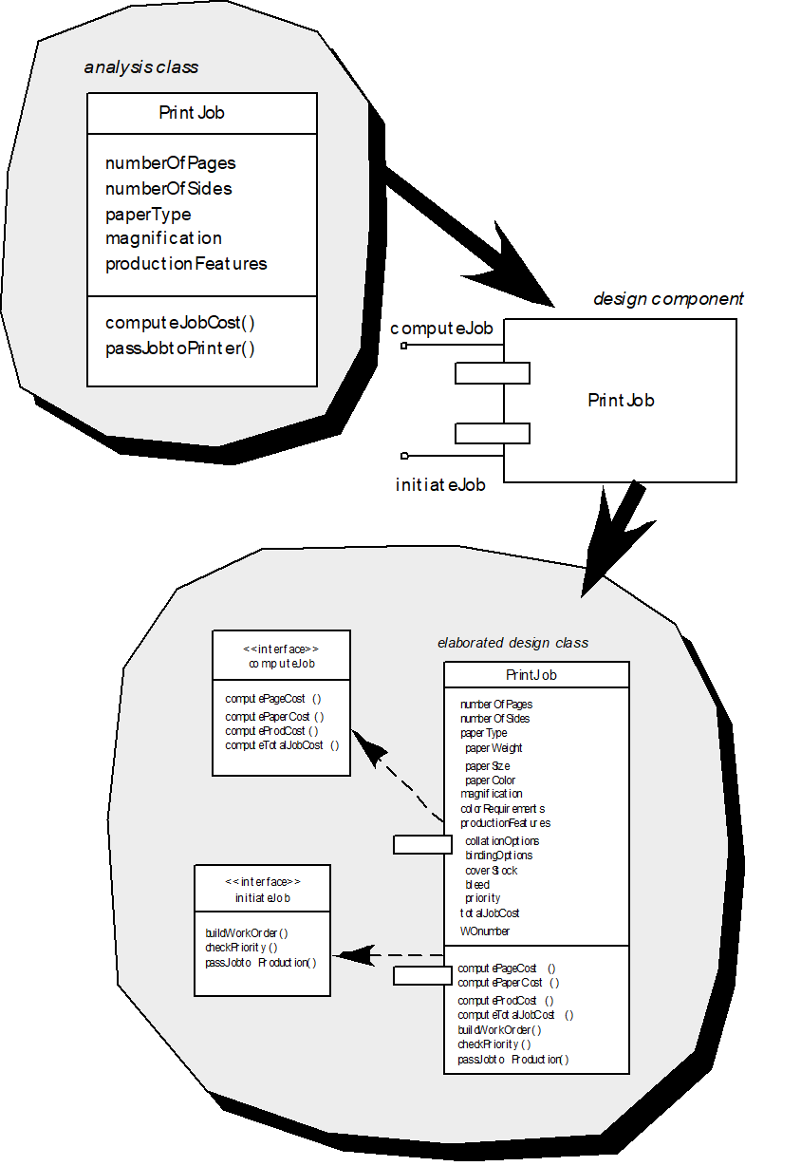

Slide 89
3.9.2 The Conventional View
Conventional view: a component is a functional element of a program that incorporates processing logic, the internal data structures that are required to implement the processing logic, and an interface that enables the component to be invoked and data to be passed to it.
A conventional component, also called a module, resides within the s/w architecture and serves one of three important roles as:
A control component that coordinates the invocation of all other problem domain components,
A problem domain component that implements a complete or partial function that is required by the customer,
An infrastructure component that is responsible for functions that support the processing required in the problem domain.

Slide 90
